Slide 1

BASICIS OF CIVIL ENGINEERING & MECHANICS
Course code:CV14/CV24
Credits:3:0:0
Basic Materials of Construction

Slide 2

DEPARTMENT OF
CIVIL ENGINEERING
Course: Basics of Civil Engineering & Mechanics
Credits: 3:0:0
Basic Materials of Construction
Construction materials or Building materials is a material used for construction. Many naturally occurring substances, such as clay, rocks, sand and wood, have been used to construct buildings.
Apart from naturally available materials, many man-made products are in use, some more and some less synthetic.

Slide 3
DEPARTMENT OF
CIVIL ENGINEERING
Course: Basics of Civil Engineering & Mechanics
Credits: 3:0:0
Basic Materials of Construction
Materials used in building construction have to be selected carefully to ensure the safety and long-lasting life of the building
There are many types of building materials used in construction such as Cement, Bricks, sand, Stones, Concrete, Steel, Wood and Masonry.

Slide 4
DEPARTMENT OF
CIVIL ENGINEERING
Course: Basics of Civil Engineering & Mechanics
Credits: 3:0:0
Bricks
Bricks are one of the oldest and first building material (except wood) were made of mud molded by hand and dried in sun for a days until they were strong enough for use dating back to 7000BC
The transition from the traditional method of production known as hand molding to a mechanized form of mass production slowly took place during the first half of nineteenth century.

Slide 5
DEPARTMENT OF
CIVIL ENGINEERING
Course: Basics of Civil Engineering & Mechanics
Credits: 3:0:0
Classification of Bricks
Based on the manufacturing process, bricks are broadly classified into two types,
Sun-Dried or unburnt bricks
Burnt bricks
Burnt bricks are classified into four types and they are
First class bricks
Second class bricks
Third class bricks
Fourth class bricks

Slide 6
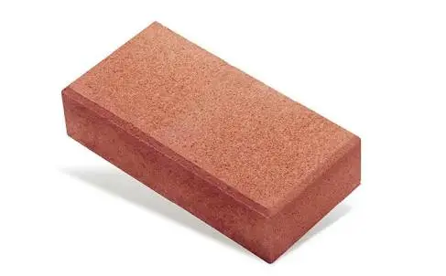
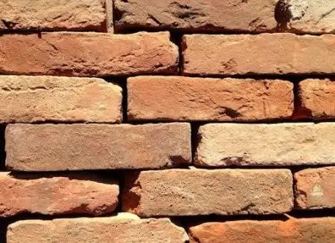
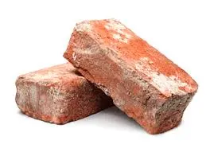
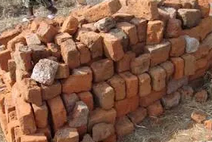
DEPARTMENT OF
CIVIL ENGINEERING
Course: Basics of Civil Engineering & Mechanics
Credits: 3:0:0
Classification of Bricks
First class bricks
b) Second class bricks
c) Third class bricks
d) Fourth class bricks

Slide 7
DEPARTMENT OF
CIVIL ENGINEERING
Course: Basics of Civil Engineering & Mechanics
Credits: 3:0:0
Properties of Bricks
The following are the required properties of good bricks:
Colour 8. strength
Shape 9. Water Absorption
Size 10. Efflorescence
Texture 11. Thermal Conductivity
Soundness 12. Sound insulation
Hardness 13. Fire Resistance
Strength
Notes:
[1] COLOUR: The bricks should be uniform and bright.
[2] SHAPE: Bricks should have plane faces. They should have sharp and true right angled corners.
[3] SIZE: Bricks should be of standard sizes as prescribed by codes.
[4] TEXTURE: Bricks should possess fine, dense and uniform texture. They should not possess fissures, cavities, loose grit and unburnt lime.
[5] SOUNDNESS: When the brick is struck with hammer or with another brick, it should produce metallic sound.
[6] HARDNESS: Finger scratching should not produce any impression on the brick.
[7] STRENGTH: The Crushing strength of brick should not be less than 3.5 N/mm². A field test for strength is that when dropped from a height of 0.9 m to 1.0 m on a hard ground, the brick should not break into pieces.
[8] WATER ABSORPTION: After immersing the brick in water for 24 hours, water absorption should not be more than 20% by weight. For class-I works this limit is 15%.
[9] EFFLORESCENCE: Bricks should not show white patches when soaked in water for 24 hours and then allowed to dry in shade. White patches are due to the presence of sulphate of calcium, magnesium and potassium. They keep the masonry permanently in damp and wet conditions.
[10] THERMAL CONDUCTIVITY: Bricks should have low thermal conductivity, so that buildings built with them are cool in summer and warm in winter.
[11] SOUND INSULATION: Heavier bricks are poor insulators of sound while lightweight and hollow bricks provide good sound insulation.
[12] FIRE RESISTANCE: Fire resistance of bricks is usually good. In fact bricks are used to encase steel columns to protect them from fire.

Slide 8
DEPARTMENT OF
CIVIL ENGINEERING
Course: Basics of Civil Engineering & Mechanics
Credits: 3:0:0
Field and Laboratory tests on Bricks
Absorption
Crushing strength or compression strength
Hardness
Presence soluble salts
Shape and size
Soundness
Structure
Colour and Appearance
Impact test

Slide 9
DEPARTMENT OF
CIVIL ENGINEERING
Course: Basics of Civil Engineering & Mechanics
Credits: 3:0:0
Advantages of Bricks
Economical (Raw material is easily available)
Hard and durable
Compressive strength is good enough for ordinary construction
Different orientations and sizes give different surface textures
Very low maintenance cost is required

Slide 10
DEPARTMENT OF
CIVIL ENGINEERING
Course: Basics of Civil Engineering & Mechanics
Credits: 3:0:0
Demolishing of brick structures is very easy, less time consuming and hence economic
Reusable and Recyclable
Highly fire resistant
Produces less environmental pollution during manufacturing process

Slide 11
DEPARTMENT OF
CIVIL ENGINEERING
Course: Basics of Civil Engineering & Mechanics
Credits: 3:0:0
Disadvantages of Bricks
Time consuming construction
Cannot be used in high seismic zones
Since bricks absorb water easily, therefore, it causes fluorescence when not exposed to air
Very Less tensile strength
Rough surfaces of bricks may cause mold growth if not properly cleaned
Cleaning brick surfaces is a hard job
Colour of low quality brick changes when exposed to sun for a long period of time

Slide 12
DEPARTMENT OF
CIVIL ENGINEERING
Course: Basics of Civil Engineering & Mechanics
Credits: 3:0:0
Cement
A cement is a binder substance used for construction that sets, hardens, and adheres to other materials to bind them together.
Cement mixed with fine aggregate produces mortar for masonry, or with sand and gravel, produces concrete.
Cement can be classified into two distinct categories according to their respective setting and hardening mechanisms:
Non-hydraulic cement
Hydraulic cement

Slide 13
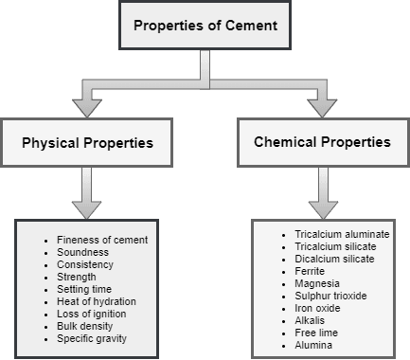
DEPARTMENT OF
CIVIL ENGINEERING
Course: Basics of Civil Engineering & Mechanics
Credits: 3:0:0
Cement

Slide 14
DEPARTMENT OF
CIVIL ENGINEERING
Course: Basics of Civil Engineering & Mechanics
Credits: 3:0:0
Cement
Field tests conduct to check the quality of cement
1. Manufacturing date of cement.
2. Colour of cement.
3. Presence of lumps.
4. Adulteration test.

Slide 15
DEPARTMENT OF
CIVIL ENGINEERING
Course: Basics of Civil Engineering & Mechanics
Credits: 3:0:0
Cement
5. Temperature test.
6. Float test.
7. Strength test.
8. Set test.

Slide 16
DEPARTMENT OF
CIVIL ENGINEERING
Course: Basics of Civil Engineering & Mechanics
Credits: 3:0:0
Cement
Laboratory tests conduct to check the quality of cement
Fineness Test.
Consistency Test.
Setting Time Test.
Strength Test.

Slide 17
DEPARTMENT OF
CIVIL ENGINEERING
Course: Basics of Civil Engineering & Mechanics
Credits: 3:0:0
Cement
Soundness Test.
Heat of Hydration Test.
Tensile Strength Test.
Chemical Composition Test.

Slide 18
DEPARTMENT OF
CIVIL ENGINEERING
Course: Basics of Civil Engineering & Mechanics
Credits: 3:0:0
Types of Cement
Ordinary Portland Cement (OPC)
Portland Pozzolana Cement (PPC)
Rapid Hardening Cement
Quick setting cement
Low Heat Cement
Sulphate resisting cement

Slide 19
DEPARTMENT OF
CIVIL ENGINEERING
Course: Basics of Civil Engineering & Mechanics
Credits: 3:0:0
Types of Cement
Blast Furnace Slag Cement
High Alumina Cement
White Cement
Colored cement
Air Entraining Cement
Expansive cement
Hydrographic cement

Slide 20
DEPARTMENT OF
CIVIL ENGINEERING
Course: Basics of Civil Engineering & Mechanics
Credits: 3:0:0
Uses of Cement
It is used in mortar for plastering, masonry work, pointing, etc.
It is used for making joints for drains and pipes.
It is used for water tightness of structure.
It is used in concrete for laying floors, roofs and constructing lintels, beams, stairs, pillars etc.
It is used where a hard surface is required for the protection of exposed surfaces of structures against the destructive agents of the weather and certain organic or inorganic chemicals.

Slide 21
DEPARTMENT OF
CIVIL ENGINEERING
Course: Basics of Civil Engineering & Mechanics
Credits: 3:0:0
Uses of Cement
It is used for precast pipes manufacturing, piles, fencing posts etc.
It is used in the construction of important engineering structures such as bridges, culverts, dams, tunnels, lighthouses etc.
It is used in the preparation of foundations, watertight floors, footpaths etc.
It is employed for the construction of wells, water tanks, tennis courts, lamp posts, telephone cabins, roads etc.

Slide 22
DEPARTMENT OF
CIVIL ENGINEERING
Course: Basics of Civil Engineering & Mechanics
Credits: 3:0:0
Mortar
Mortar is a workable paste which hardens to bind building units such as stones, bricks, and concrete masonry units, and also to fill and seal the Irregular gaps between them.
Functions of Mortar
Binds together bricks or stones.
Provides strength to the structure.
It offers cohesion or force between the structural unit.

Slide 23
DEPARTMENT OF
CIVIL ENGINEERING
Course: Basics of Civil Engineering & Mechanics
Credits: 3:0:0
Mortar
It serves as an important medium for uniformly distributing the forces through the structure.
Imparts additional resistance and power against the rain dispersion and other such weathering agencies.
It fills up empty joints in brick or stone masonry. Typically, a thin liquid mortar known as Grout is used for such purposes.

Slide 24
DEPARTMENT OF
CIVIL ENGINEERING
Course: Basics of Civil Engineering & Mechanics
Credits: 3:0:0
Properties of Mortar
Workability
Strength
Water retention
Adhesive properties
Durability
Crack resistance

Slide 25
DEPARTMENT OF
CIVIL ENGINEERING
Course: Basics of Civil Engineering & Mechanics
Credits: 3:0:0
Types of Mortar
Based on the binding material used
Cement Mortar
Lime Mortar
Gypsum Mortar
Gauged Mortar
Surkhi Mortar
Aerated Cement Mortar
Mud Mortar

Slide 26
DEPARTMENT OF
CIVIL ENGINEERING
Course: Basics of Civil Engineering & Mechanics
Credits: 3:0:0
Types of Mortar
Based on it’s application
Bricklaying Or Stone-Laying Mortar
Finishing Mortar
Thin set
Based on the Bulk Density
Heavy Mortar
Light Weight Mortar

Slide 27
DEPARTMENT OF
CIVIL ENGINEERING
Course: Basics of Civil Engineering & Mechanics
Credits: 3:0:0
Special Purpose Mortar
Fire Resistant Mortar
Packing Mortar
Sound Absorbing Mortar
Chemical resistant Mortar
X-ray shielding Mortar

Slide 28
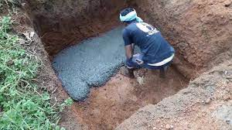
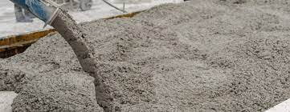
DEPARTMENT OF
CIVIL ENGINEERING
Course: Basics of Civil Engineering & Mechanics
Credits: 3:0:0
Plain Cement Concrete:
Plain cement concrete is the mixture of cement, fine aggregate (sand) and coarse aggregate without steel.
Uses: For foundation work and Building Flooring.

Slide 29
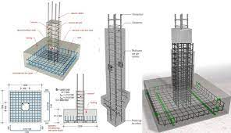
DEPARTMENT OF
CIVIL ENGINEERING
Course: Basics of Civil Engineering & Mechanics
Credits: 3:0:0
Reinforced Cement Concrete:
1. Reinforced cement concrete (RCC) is PCC + reinforcement.
2.The reinforcement can be both tensile or compressive reinforcement depending upon the situation.
Uses: Construction of bridges, dams, piers, tall buildings.

Slide 30
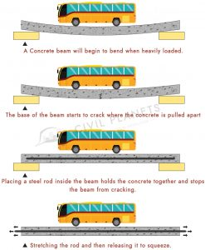
DEPARTMENT OF
CIVIL ENGINEERING
Course: Basics of Civil Engineering & Mechanics
Credits: 3:0:0
Prestressed Concrete:
“Pre-stressed concrete is a form
of reinforced concrete that builds
In compressive stresses during
Construction to oppose those
found when in use.”
In other words it is a combination
Of steel and concrete that takes
advantages of the strengths of each
Material.

Slide 31
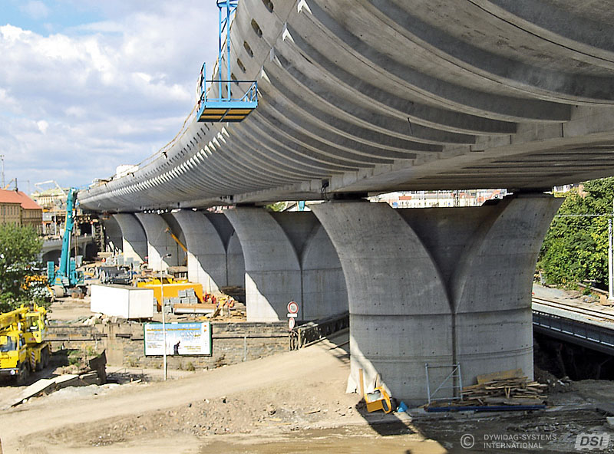
DEPARTMENT OF
CIVIL ENGINEERING
Course: Basics of Civil Engineering & Mechanics
Credits: 3:0:0
Applications of Prestressed Concrete
Bridges
Slabs in buildings
Water tanks
Concrete Pile
Thin shell structures
Offshore platform
Nuclear Power Plant
Repair and Rehabilitations

Slide 32
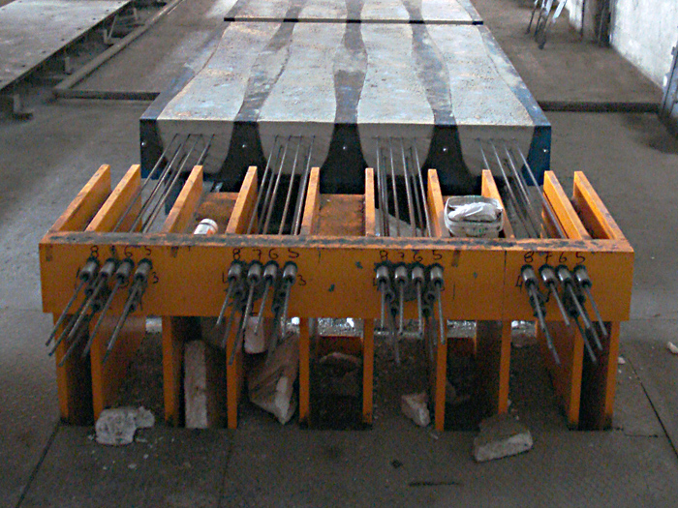
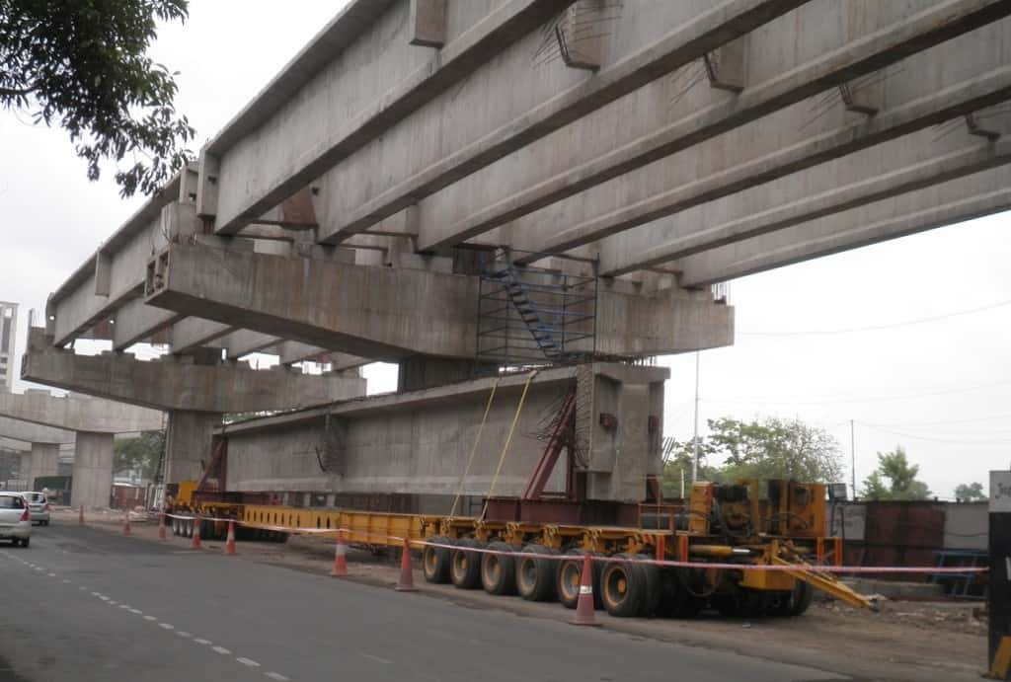
DEPARTMENT OF
CIVIL ENGINEERING
Course: Basics of Civil Engineering & Mechanics
Credits: 3:0:0

Slide 33
BASICIS OF CIVIL ENGINEERING & MECHANICS
Course code:CV14/CV24
Credits:3:0:0

Slide 34
DEPARTMENT OF
CIVIL ENGINEERING
Course: Basics of Civil Engineering & Mechanics
Credits: 3:0:0
Structural steel
Structural steel is a carbon steel, meaning it has a carbon content of up to 2.1 percent by weight. After iron, carbon is the most important element in carbon steel

Slide 35
DEPARTMENT OF
CIVIL ENGINEERING
Course: Basics of Civil Engineering & Mechanics
Credits: 3:0:0
Properties of Structural steel
1. Density
2. Elastic Modulus
3. Poisson's Ratio
4. Tensile Strength
5. Yield Strength
6. Melting Point
7. Specific Heat
8. Hardness

Slide 36

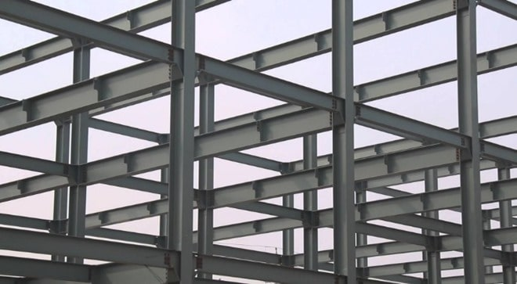


DEPARTMENT OF
CIVIL ENGINEERING
Course: Basics of Civil Engineering & Mechanics
Credits: 3:0:0
Applications of Structural Steel

Slide 37
DEPARTMENT OF
CIVIL ENGINEERING
Course: Basics of Civil Engineering & Mechanics
Credits: 3:0:0
Role of Water in Construction
Water is the most important & least expensive ingredient of concrete. It plays an important role in mixing, laying, compaction, setting & hardening of concrete.
The functions of water in the concrete mix are given below:
It acts as a lubricant for the fine and coarse aggregate & makes the mixture workable.
It acts chemically with cement to form the binding paste.

Slide 38
DEPARTMENT OF
CIVIL ENGINEERING
Course: Basics of Civil Engineering & Mechanics
Credits: 3:0:0
Role of Water in Construction
It is employed to damp the aggregate surface in order to prevent them from absorbing water vitally necessary for chemical action.
It facilitates the spreading of aggregate.
It helps to flux the cementing material over the surface of the aggregate.
It enables the concrete mix to flow into moulds.

Slide 39
DEPARTMENT OF
CIVIL ENGINEERING
Course: Basics of Civil Engineering & Mechanics
Credits: 3:0:0
Quality Of Mixing Water In Concrete
1. It should be fresh & clean.
2. It should be free from organic impurities injurious amounts of acids or alkalies, hygroscopic, greasy & oily substance.
3. It should be free from iron, vegetable matter, or any other substance which is likely to have an adverse effect on concrete or reinforcement.
4. It should be fit for drinking purpose.
5. The PH value shall generally be between 6 and 8.

Slide 40
DEPARTMENT OF
CIVIL ENGINEERING
Course: Basics of Civil Engineering & Mechanics
Credits: 3:0:0
Construction Chemicals
Construction chemicals have always been playing important roles in virtually all sorts of construction projects, be it industrial projects, residential building projects, commercial building projects and so on.
These chemicals are often used in various elements of projects in order to achieve various important qualities such as workability, durability etc. Construction chemicals exist in many varieties from a large number of manufacturers worldwide.

Slide 41
DEPARTMENT OF
CIVIL ENGINEERING
Course: Basics of Civil Engineering & Mechanics
Credits: 3:0:0
Types of Construction Chemicals
Concrete Hardeners
Protective and Decorative coating
Epoxy Coating
Mould Releasing Agents
Polymer Bonding Agent
Ready Mix Plaster
Waterproofing Chemicals

Slide 42

DEPARTMENT OF
CIVIL ENGINEERING
Course: Basics of Civil Engineering & Mechanics
Credits: 3:0:0
Carbon Composites
Carbon/carbon composites are special kind of composite that consists of carbon fibers embedded in a carbonaceous matrix.

Slide 43
DEPARTMENT OF
CIVIL ENGINEERING
Course: Basics of Civil Engineering & Mechanics
Credits: 3:0:0
Properties of carbon-carbon composites material
High temperature resistance
Thermal shock resistance
Low thermal expansion coefficient
Small heat capacity
Low density
Excellent corrosion resistance and radiation performance.

Slide 44
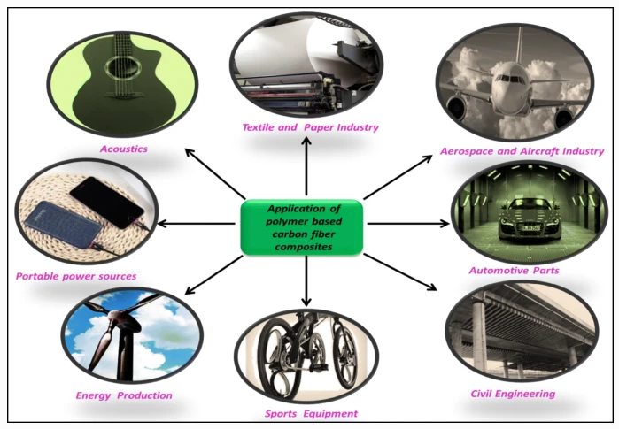
DEPARTMENT OF
CIVIL ENGINEERING
Course: Basics of Civil Engineering & Mechanics
Credits: 3:0:0

Slide 45

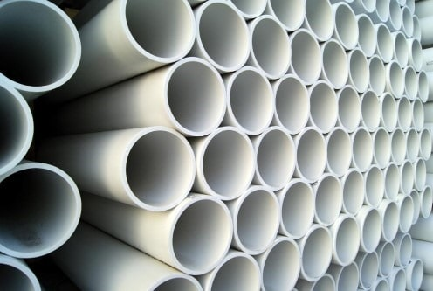

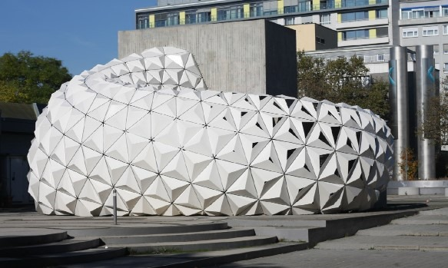
DEPARTMENT OF
CIVIL ENGINEERING
Course: Basics of Civil Engineering & Mechanics
Credits: 3:0:0
Plastic in Construction
Properties
Appearance
Chemical resistance
Dimensional stability
Ductility
Durability
Electric insulation
Finishing
Fire resistance
Fixing
Humidity

Slide 46
DEPARTMENT OF
CIVIL ENGINEERING
Course: Basics of Civil Engineering & Mechanics
Credits: 3:0:0
Applications of Plastic in Construction Industry
Facade panels, exterior covering, carpentry
Interior Covering, Floors, Walls, Ceilings, Doors, Partitions
Sanitary Equipment and Piping

